Slide 1


Power BI Lunch and Learn
Flat File to Star Schema
We will begin at 1:05 pm CT

Slide 2

Chad Toney
About Me
Senior Cloud Solution Architect - Data & AI Kansas City, MO
12+ years of data and analytics
10+ years of health care, quality reporting, and payer data
Power BI, Analysis Services, SSRS
BI Manager & Product Manager

Slide 3
PBI Team
Power BI Team | Role | PBI Updates (03/15):
Carrie Ruckdeschel | PBI Team Lead | March 29th is CDW Insights – a collaboration special. Our presentation is at 1pm EST with guest speaker Kelli Rasmussen, MS, Senior Research Analyst - "Intelligent Care - Integration of Power BI and Power Apps". See the full agenda here - CDW Insights March 29th New additional monthly Fundamentals course (3 total) are being extend through the rest of the year. Lunch & Learn sessions are first and third Wednesdays 2 PM ET. Meeting info, presentations and recordings, and survey form is on our Lunch & Learn page. Let us know if you'd would like to be a guest speaker. The CDWNG CoE team has delivered several great trainings on Power BI, Synapse, other Azure. Please see their Training Options (sharepoint.com) page on their SP site for recorded and upcoming trainings. Check out the recordings pertaining to Power BI - Incremental Refresh and Hybrid Tables in Power BI , Reporting with Azure Synapse Analytics and Power BI.
Austin Gainey | PBI RS/SSRS Team Lead
Bill Stein | PBI Support, Training, Office Hours DJ
Krystal Maher | PBI Support, Training
Ryan Ceniceros | PBI Support, Provisioning
Salem Hamiani | PBI Support, Provisioning
Lavanya Epuri | PBI Platform Support
Chad Toney | PBI Platform Support
David Burkhart | CDW Guru
Greg Price | CDW Training
*Shabnam Watson | CDWNG Data Engineering Team Lead
*Mason Prewett | CDWNG Data Engineering Team
Notes:
Welcome
PBI Updates
Ground Rules
Raise your hand using the Teams Reactions
One question per person, then you may raise your hand again for another question
No PHI or PII

Slide 4
Flat File to Star Schema
Notes:
Power BI prefers that we model our data in a Star Schema, in Facts and Dimensions.
What are facts and dimensions?
Facts are the activities you are measuring
Dimensions are the the things you measure by.
Slice
Many times, our data is already modeled for us in a Data Warehouse.
This is still best
Ask your DBA for a star schema.
But if you're working with raw data from a sharepoint list or excel or csv or don't have the ability to model your data in at the source, you can do it in Power BI

Slide 5
Facts and dimensions
The difference between facts and dimensions is the core of star schemas and BI modeling

Slide 6
Facts vs Dimensions
Different entities need different ways of handling
Fact: something that happened
The sale of a product to a customer
A cash withdrawal on an ATM machine
The signature of an order
The prescription of a medical treatment
Dimension: something that describes a fact
Attribute of a fact
The name of the customer, or of the patient
The date when the fact happened
The currency of the cash withdrawal

Slide 7
Some important notes about facts
The fact table is typically the largest one
You can have billions of sales
But it is unlikely you have billions of customers
Fact are associated with numbers
Amount withdrawn, quantity of the product sold
Not all numbers belong to facts
Price of a product: belongs to the dimension
Quantity of products: belongs to the fact table
Measures are typically aggregation of numbers from the fact table
SUM ( Sales[Quantity] )

Slide 8
Some important notes about dimensions
Dimensions are typically small tables
1 million rows, for a dimension, is already a large number
Dimensions contain a lot of strings
Customer name, address, gender, education
Product color, size, brand, manufacturer
You typically slice by dimensions
When you compute something, you count them
Number of customers
Number of products
Dimensions are not related each other

Slide 9
What makes a dimension?
One business entity=one table
Attributes of an entity in the same table
Customer is a business entity
Attributes: city, country, region, education, gender, age
Usually, country is not an entity
It is an attribute of other dimensions
Country of customer, country of store
Exception: demographic data
Measure: population (fact table)
Dimension: country (which is an entity in this model)

Slide 10

Introducing star schemas
Star schemas are the most popular way of modeling data in Business Intelligence

Slide 11
Placing tables in a diagram
Fact table
Stands, alone, in the center
Dimensions
All around the fact table
Directly linked to it
The figure that appears looks like a star
Hence, the name: star schema

Slide 12
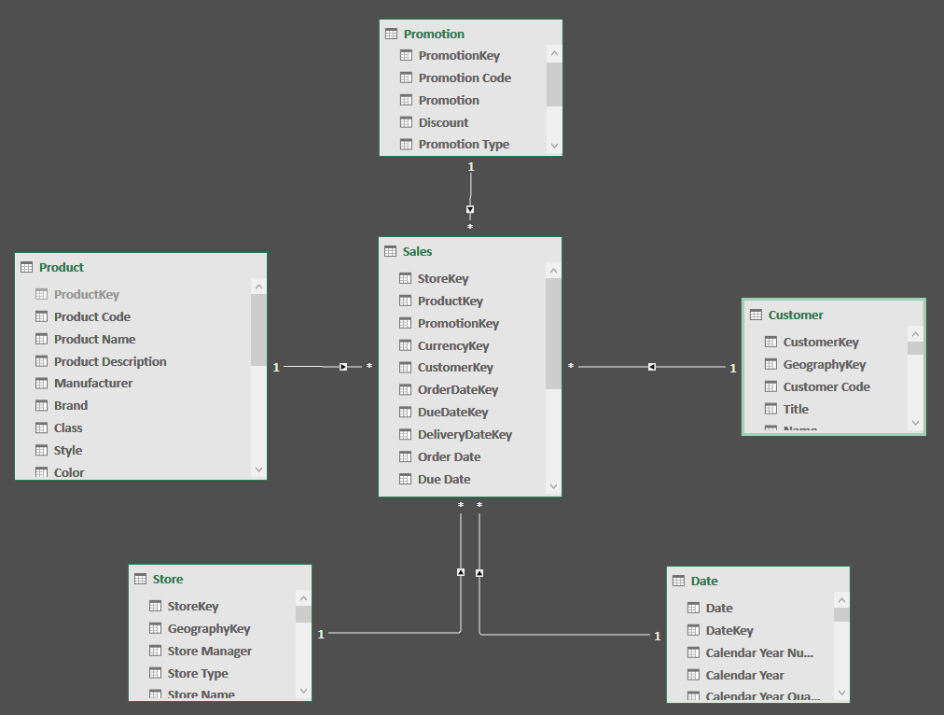
Introducing star schemas
Dimension
Dimension
Fact
Dimension
Dimension
Dimension

Slide 13
Star schemas
Very easy to understand at first glance
You slice by dimensions and aggregate facts
There is no ambiguity
Very fast
Modern engines are optimized for star schemas
Drive a clean modeling path
Numbers go in the fact table
Strings go in the dimension
Everything else…we need to understand what it is

Slide 14
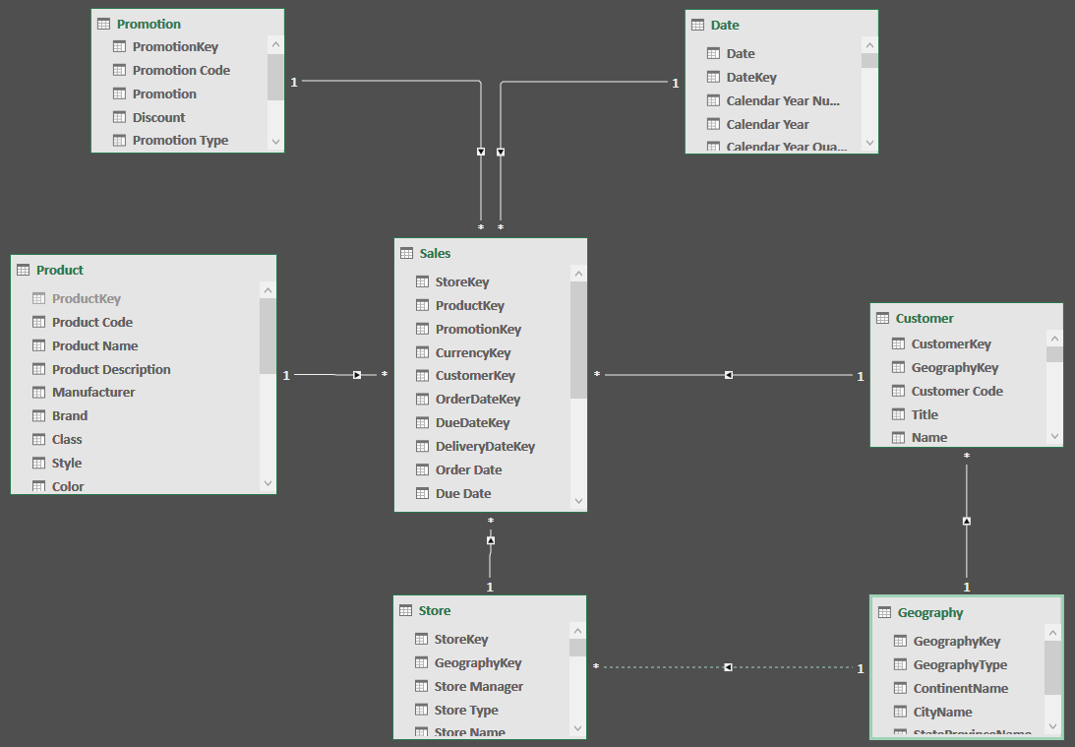
Ambiguous model: not a star schema
Which path should the engine take when slicing by ContinentName?
Store or Customer?
Dimensions should not refer each other

Slide 15
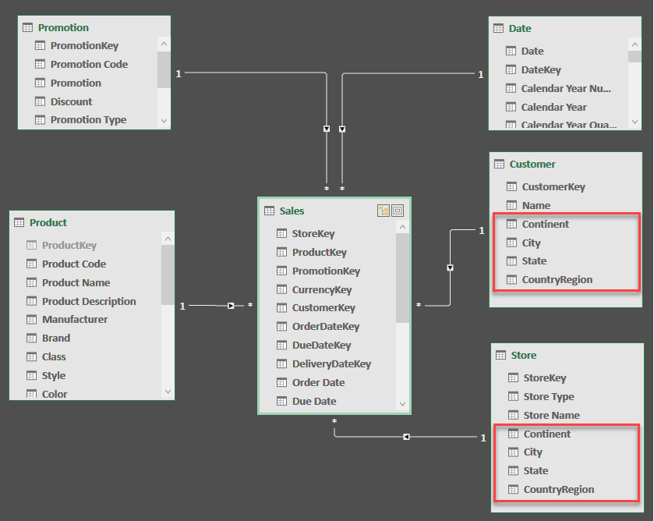
Solving ambiguity: back to a star schema
Dimension
Dimension
Dimension
Fact
Data is duplicated, but the overall model is much simpler to use
Dimension
Dimension

Slide 16
How many dimensions?
One entity=one dimension
More dimensions are often useless and confusing
Number of dimensions:
10 dimensions is good
20 dimensions is probably wrong
30 dimensions is totally wrong
Dimension/attribute ratio:
1 dimension with 20 attributes is good
20 dimensions with 1 attribute is bad

Slide 17
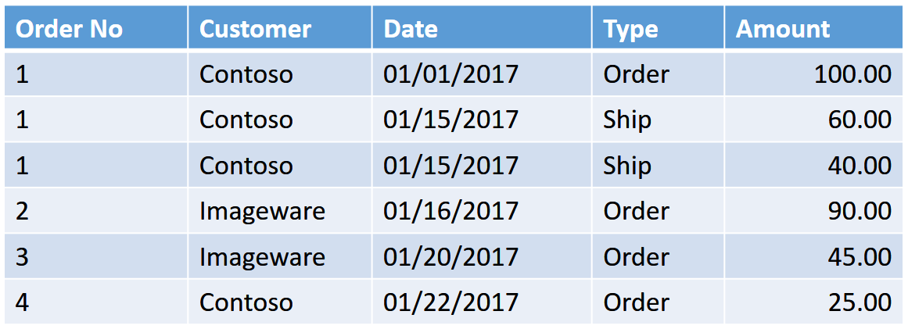
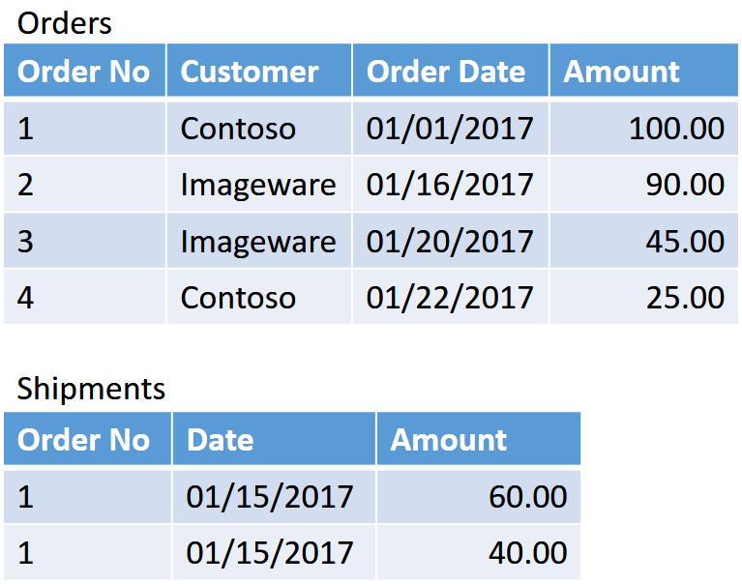
How many fact tables?
Multiple events merged
Correct model
Computing the orders not yet shipped in this model is a complex operation

Slide 18
Demo

Slide 19
Next Steps - Optional
Star Schema help: chad.toney@va.gov
Advanced Modeling – monthly 4th Monday
Lunch and Learn Data Models Session 1-4

